Slide 1

Gym Website – Muscle Up Gym
Software Requirements Specification
20-04-2024
Final Report/Supporting Document
Frontend Development (INT-219)
By
Sr. No. | Registration No | Name of Student | Roll No | Total Marks | Marks Obtained
1 | 12221896 | Mohit | 66
Submitted To Palvi soni Mam, Assistant Professor,
Lovely Professional University

Slide 2
Jalandhar, Punjab, India.
Final report (INT-219)
Title: Gym Website
Name: Mohit
Registration Number: 12221896
Roll Number: 66
Section: K22PA Term: 223242
Prepared for Continuous Assessment 3
2024

Slide 3
Acknowledgement
I have taken efforts in this project. However, it would not have been possible without the kind support and help of many individuals and organizations. I would like to extend my sincere thanks to all of them.
I am highly indebted to Palvi soni Mam for their guidance and constant supervision as well as for providing necessary information regarding the project & also for their support in completing the project.
I would like to express my gratitude towards my parents & member of for their kind co- operation and encouragement which help me in completion of this project.
I would like to express my special gratitude and thanks to industry persons for giving me such attention and time.
My thanks and appreciations also go to my colleague in developing the project and people who have willingly helped me out with their abilities.

Slide 4
Preface
The main objective of any computer science student is to get as much of practical knowledge as
possible. Being an able to have a practical knowledge by developing a project is a lifetime experience. As practical knowledge is as important
as theoretical knowledge we are thankful of having a project. Through the development of the project we had a great experience of various
strategies that can be applied in development of project. This project is
the stepping stone for our carrier. We are pleased to present this project. Proper care has been taken while organizing the project so that it is to comprehend.

Slide 5
Table of Contents
REVISION HISTORY ........................................................................... ERROR! BOOKMARK NOT DEFINED.
CLIENT APPROVAL............................................................................ ERROR! BOOKMARK NOT DEFINED.
INTRODUCTION ............................................................................................................................................ 1
PURPOSE...................................................................................................................................................... 2
SCOPE.......................................................................................................................................................... 2
DEFINITIONS, ACRONYMS, AND ABBREVIATIONS......................................................................................... 3
OVERVIEW .................................................................................................................................................. 4
GENERAL DESCRIPTION............................................................................................................................. 5
PRODUCT PERSPECTIVE .............................................................................................................................. 5
PRODUCT FUNCTIONS.................................................................................................................................. 6
USER CHARACTERISTICS ............................................................................................................................. 7
GENERAL CONSTRAINTS ............................................................................................................................. 8
ASSUMPTIONS AND DEPENDENCIES ............................................................................................................. 9
SPECIFIC REQUIREMENTS....................................................................................................................... 10
EXTERNAL INTERFACE REQUIREMENTS .................................................................................................... 11
User Interfaces................................................................................................................................... 12
Hardware Interfaces .......................................................................................................................... 13
Software Interfaces ............................................................................................................................ 15
Communications Interfaces ............................................................................................................... 16
FUNCTIONAL REQUIREMENTS ................................................................................................................... 17
<Functional Requirement or Feature #1> ................................................Error! Bookmark not defined.
<Functional Requirement or Feature #2> ................................................Error! Bookmark not defined.
NON-FUNCTIONAL REQUIREMENTS........................................................................................................... 18
Performance .............................................................................................Error! Bookmark not defined.
Reliability..................................................................................................Error! Bookmark not defined.
Availability................................................................................................Error! Bookmark not defined.
Security.....................................................................................................Error! Bookmark not defined.
Maintainability .........................................................................................Error! Bookmark not defined.
Portability .................................................................................................Error! Bookmark not defined.
3.7 DESIGN CONSTRAINTS ............................................................................................................................... 19
3.9 OTHER REQUIREMENTS ............................................................................ERROR! BOOKMARK NOT DEFINED.
ANALYSIS MODELS .................................................................................................................................... 21
DATA FLOW DIAGRAMS (DFD) ................................................................................................................. 22
GITHUB LINK…………………………………………………………………………………………………….5
6 Main Code……………………………………………………………………………………………….6
7. Snap shots………………………………………………………………………………………………
………7

Slide 6
1. Introduction
The Software Requirement Specification (SRS) document serves as a comprehensive guide detailing the functional and non-functional requirements for the development of a Gym website. This document is intended to provide software engineers with all necessary information to design and implement the software product effectively.
The Software Requirement Specification (SRS) document serves as a cornerstone in the development of a Gym website, delineating both the functional and non-functional requirements essential for its successful implementation. This comprehensive guide is meticulously crafted to furnish software engineers with a thorough understanding of the project's scope, objectives, and intricacies, empowering them to navigate the development process with clarity and precision.
**Audience**
This SRS document is tailored to cater to a diverse audience of stakeholders, each with their own unique perspective and expertise. Primarily intended for software engineers tasked with the development and implementation of the weather website, it provides a comprehensive overview of the project's requirements and constraints, equipping them with the knowledge and insights needed to navigate the complexities of software engineering. Additionally, it serves as a communication tool, bridging the gap between technical and non-technical stakeholders, fostering collaboration and alignment across disparate teams and disciplines.
This document is intended for software engineers involved in the development process, including analysts, designers, developers, and testers. It provides them with a clear understanding of the project requirements and serves as a reference throughout the software development lifecycle.
**Document Conventions**
To facilitate clarity and consistency, this SRS adheres to a set of predefined conventions and standards. From naming conventions and notation to formatting guidelines and terminology, every aspect of the document is carefully curated to ensure coherence and cohesion. Moreover, it draws upon established frameworks and methodologies, such as the IEEE Guide to SRS, to provide a common language and reference point for stakeholders, thereby fostering collaboration and alignment across disparate teams and disciplines.
This section outlines any specific conventions or standards followed throughout the document, such as naming conventions, notation, and formatting guidelines, to ensure consistency and clarity.
**Revision History**

Slide 7
As a living document, this SRS is subject to continual refinement and evolution. Each revision reflects the collective wisdom and experience of stakeholders, incorporating feedback and insights gathered throughout the development process. Moreover, it serves as a historical record, documenting the evolution of the project over time and providing valuable insights into the decision-making process and rationale behind key design choices and iterations.
This section provides a record of changes made to the document, including the date of revision and a brief description of the changes implemented. It helps maintain traceability and transparency throughout the development process.
1.1 Purpose
The primary purpose of this SRS document is to outline the requirements and specifications for the development of a Gym website that provides accurate and reliable Health information to users. It serves as a blueprint for software engineers to understand the scope of the project and to ensure that the final product meets the expectations and needs of the stakeholders.
The primary purpose of this SRS document is multifaceted. It acts as a roadmap, illuminating the path from conception to fruition, ensuring alignment between stakeholder expectations and the final product. By encapsulating the project's requirements, constraints, and desired outcomes, it provides a unified vision for all parties involved, fostering cohesion and synergy throughout the development lifecycle. Moreover, it serves as a foundational artifact, laying the groundwork for design, implementation, testing, and maintenance phases, thereby streamlining the entire software engineering endeavor.
1.2Scope
**1.1 Software Product(s) Identification**
The software product to be produced is a comprehensive Gym website, referred to as “Muscle Up Gym" in this specification.
**1.2 Software Product(s) Overview**
Muscle Up Gym is dedicated to empowering your fitness journey with a comprehensive and results-oriented approach. We provide a welcoming and motivating environment equipped with everything you need to achieve your strength and conditioning goals..
**1.3 Application of the Software**
Muscle Up Gym offers a comprehensive mobile application designed to complement your in-gym experience and empower your fitness journey. Here's how the app can be applied:

Slide 8
(a) Relevant Benefits, Objectives, and Goals:
Enhanced Tracking and Progress Monitoring: The app allows users to seamlessly track workouts, log sets and reps, and monitor their progress over time. This fosters accountability and helps users stay motivated towards their fitness goals.
Personalized Training Support: Users can access a library of on-demand workouts categorized by muscle group, fitness level, and goals. Additionally, the app may facilitate communication with trainers for personalized coaching and guidance.
Community Connection and Engagement: The Muscle Up Gym app can foster a sense of community by allowing users to connect with other gym members, share workout achievements, and participate in fitness challenges.
(b) Scope of the Muscle Up Gym App
The scope of the Muscle Up Gym app likely includes the following features:
Workout Tracking: Log exercises, sets, reps, and weights used during workouts.
Progress Monitoring: Track workout history and visualize overall fitness progress over time.
On-Demand Workouts: Access a library of pre-designed workout routines suitable for various goals and fitness levels.
Trainer Support: Schedule consultations, receive personalized coaching tips, and connect with trainers through the app (if applicable).
Community Features: Connect with other gym members, share workout achievements, and participate in fitness challenges (if applicable).
Gym Information: Access gym location, hours of operation, class schedules, and contact information.
1.3 Definitions, Acronyms, and Abbreviations
**1.3 Definitions, Acronyms, and Abbreviations**
To ensure clarity and consistency throughout this document, the following definitions, acronyms, and abbreviations are used in the context of the Muscle Up Gym mobile application:
Definitions:
Mobile App: A software application designed specifically for use on smartphones and other portable devices.
Fitness Tracker: A wearable electronic device that tracks and monitors various fitness-related metrics such as steps taken, distance traveled, calories burned, and heart rate.
Personalized Training: Tailored workout plans and guidance designed to meet an individual's specific fitness goals and needs.
On-Demand Workouts: A library of pre-designed workout routines readily available for users to access and complete at their convenience.

Slide 9
.
**Acronyms and Abbreviations:**
App: Application (synonymous with Mobile App in this context)
GPS: Global Positioning System (used for location-based services within the app, if applicable)
API: Application Programming Interface (may be used for integrating with wearable fitness trackers or other external services)
UI: User Interface
UX: User Experience

Slide 10
1.4Overview
** Overview of the SRS**
The Software Requirements Specification (SRS) for the Muscle Up Gym Mobile App serves as a comprehensive roadmap for its development. This section provides an outline of the document's content and organizational structure to ensure a clear understanding of the app's functionalities and requirements.
1.1 Content Description:
The SRS document is comprised of various sections, each addressing a specific aspect of the mobile app:
Introduction: Provides a high-level overview of the SRS, outlining its purpose, scope, target audience, and any relevant references or conventions used.
Definitions, Acronyms, and Abbreviations (as you already have)
General Description: This section describes the overall purpose, functionalities, and target users of the Muscle Up Gym mobile app.
Specific Requirements: This section delves into the detailed requirements of the app, including functional and non-functional requirements. Functional requirements define what the app should do, while non-functional requirements specify how the app should perform (e.g., security, usability, performance).
User Interfaces (UI) Prototypes (Optional): If available, this section can include mockups or wireframes to illustrate the visual layout and user interaction elements within the app.
System Interfaces: This section details any integrations with external systems or APIs (e.g., wearable fitness trackers) that the app may utilize.
Other Considerations: This section can address any additional aspects not covered elsewhere, such as security considerations, testing procedures, or deployment strategies.
1.2 Organizational Structure:
The SRS is organized in a clear and logical manner to promote easy navigation and comprehension. It follows a hierarchical structure, with sections and subsections categorized based on their importance and relevance. Here's a breakdown of the key aspects:
Sequential Flow: The document progresses logically, starting with introductory information and gradually delving into specific requirements and details.
Modular Approach: Each section focuses on a distinct aspect of the app, allowing stakeholders to concentrate on relevant information without getting sidetracked by unnecessary details.

Slide 11
Cross-Referencing: Where applicable, sections will reference each other to maintain consistency and avoid redundancy.
General Description
This section provides a high-level overview of the Muscle Up Gym mobile app, outlining its purpose, target audience, and the general considerations that influence its development.
2.1 Purpose
The Muscle Up Gym mobile app serves as a complementary tool to enhance the in-gym experience and empower users on their fitness journeys. It offers functionalities to track workouts, access training resources, and connect with the gym community, all conveniently accessible on a mobile device.
2.2 Target Audience
The target audience for the Muscle Up Gym mobile app encompasses:
Existing Gym Members: The app provides a valuable tool for members to optimize their workouts, track progress, and stay engaged with the gym.
Potential Gym Members: The app can serve as a showcase for the gym's offerings, attracting new members interested in a technology-driven fitness experience.
2.3 General Considerations
Integration with Gym Systems: The app should seamlessly integrate with any existing gym management systems for member logins, class schedules, and other relevant data.
Usability and User Experience: A user-friendly interface and intuitive design are crucial to ensure a positive user experience and encourage app adoption.
Scalability and Future Development: The app's architecture should be designed to accommodate future growth and the potential addition of new features and functionalities.
Security: The app should prioritize user data security by implementing robust measures to protect personal information and workout data.
2.1 Product Perspective
2.1 Product Perspective
The Muscle Up Gym mobile app exists within a competitive landscape of fitness apps and gym management tools. Understanding the product perspective is crucial to positioning the app effectively and highlighting its unique value proposition within this ecosystem.
2.1.1 Relationship with Existing Fitness Apps:

Slide 12
The Muscle Up Gym app complements existing fitness apps by offering a gym-specific experience tailored to the gym's facilities, classes, and trainers. Here's how it differentiates itself:
Focus on Gym Integration: Unlike generic fitness apps, the Muscle Up Gym app integrates seamlessly with the gym's existing systems, providing access to class schedules, trainer profiles, and gym-specific workout routines.
Community Building: The app fosters a sense of community by connecting gym members, allowing them to share workout achievements and participate in gym-organized challenges, creating a more engaging fitness experience.
2.1.2 Integration with Wearable Fitness Trackers (Optional):
The Muscle Up Gym app can potentially integrate with wearable fitness trackers to enhance its tracking capabilities. This integration can offer several benefits:
Data Synchronization: Users can synchronize workout data from their fitness trackers with the app, providing a more comprehensive view of their fitness activities.
Biometric Data Tracking: The app could potentially leverage biometric data (heart rate, calories burned) from fitness trackers to personalize workout recommendations and progress tracking.
2.1.3 Potential Collaboration with Other Fitness Service Providers (Optional):
The Muscle Up Gym app might explore future collaborations with other fitness service providers, such as healthy meal planning apps or online yoga studios. This collaboration could provide users with a more holistic and integrated approach to their wellness journey.
2.2Product Functions
2.2 Product Functions
The Muscle Up Gym mobile app offers a variety of functionalities designed to empower users on their fitness journeys. These features cater to workout tracking, personalized training guidance, and fostering a supportive gym community.
2.2.1 Workout Tracking:
Exercise Logging: Users can log individual exercises performed during their workouts, including exercise type, sets, reps, weights used, and rest periods.
Workout History: The app maintains a record of past workouts, allowing users to track their progress over time and analyze workout trends.
Progress Visualization: The app offers data visualization tools to present workout progress in charts and graphs, motivating users to stay on track and celebrate achievements.
2.2.2 Personalized Training Support:
On-Demand Workout Library: Provide a library of pre-designed workout routines categorized by muscle group, fitness level, and goals (e.g., strength training, weight loss, cardio).
Trainer Integration (Optional): If applicable, the app can facilitate communication with gym trainers for personalized workout plans, exercise form checks, and ongoing coaching.
Goal Setting and Tracking: Users can set personalized fitness goals and track their progress towards achieving them within the app.

Slide 13
2.2.3 Community Features (Optional):
Social Feed: Create a social feed within the app where users can share workout achievements, motivational messages, and fitness tips, fostering a sense of community.
Fitness Challenges: Organize and participate in gym-curated fitness challenges to add a fun and competitive element to workouts and encourage user engagement.
Leaderboards (Optional): Implement leaderboards (based on workout metrics or challenge participation) to create a friendly competitive spirit and motivate users to push their limits.
2.2.4 Additional Considerations:
Gym Information Access: Provide easy access to gym information such as location, hours of operation, class schedules, and contact details.
In-App Messaging (Optional): Allow users to communicate directly with gym staff or trainers through secure in-app messaging for inquiries or appointment scheduling.
2.3User Characteristics
Understanding the target audience for the Muscle Up Gym mobile app is essential for tailoring its functionalities and user experience to their specific needs and preferences. Here's a breakdown of some key user characteristics to consider:
2.3.1 Demographics
Age: The target age range for the app will likely be adults interested in fitness, potentially between 18 and 65 years old. However, depending on the gym's offerings, this range could be broader.
Location: Users may be located within the vicinity of the gym or even beyond, potentially attracted by the gym's reputation or unique features.
Occupation: Users' occupations may influence their workout schedules and preferences. For instance, individuals with desk jobs might prioritize flexibility-focused workouts, while athletes might seek performance-enhancing routines.
2.3.2 Technical Proficiency
Tech Savvy Users: Some users may be comfortable with technology and prefer a feature-rich app with comprehensive workout tracking and data analysis tools.
App Newbies: Others may be new to fitness apps and require a user-friendly interface with clear instructions and intuitive navigation. The app should cater to both sets of users by offering a balance of features and ease of use.
2.3.3 Frequency of Use
Regular Gym-Goers: These users will likely access the app frequently to track workouts, log progress, and stay engaged with the gym community. The app should be optimized for frequent use and offer features that support consistent workout routines.
Occasional Users: Some users might utilize the app less frequently, primarily for booking classes or accessing workout plans. The app should still provide a welcoming and engaging experience for these users.

Slide 14
2.4General Constraints
The development of the Muscle Up Gym mobile app will be subject to certain limitations and considerations that need to be addressed. Here's an overview of some key general constraints:
Data Integration and Management:
Data Source Reliability: The app's functionality relies on the accuracy and consistency of data retrieved from gym management systems or wearable fitness trackers (if applicable). Limitations in data quality or availability from these external sources could impact the app's effectiveness.
Data Security: The app must prioritize user privacy by implementing robust security measures to protect sensitive personal data, such as workout details and health information (if collected from wearables). Strong encryption and user authentication protocols are crucial.
Performance and Scalability:
User Load Management: The app should be able to handle fluctuations in user traffic, particularly during peak hours or when new features are launched. Scalability considerations are important to ensure the app performs well under varying usage loads.
Device Compatibility: The app should function seamlessly across various smartphone operating systems and a range of device models. Balancing feature complexity with efficient performance across different devices is essential.
Technical Dependencies:
Integration Challenges: Integrating with the gym's existing management systems or wearable fitness trackers (if applicable) might pose technical challenges. Compatibility issues or limitations in APIs could require workarounds or alternative solutions.
Ongoing Maintenance: The app will require ongoing maintenance to address bugs, update features, and ensure compatibility with evolving operating systems and device hardware. Resource allocation for maintenance needs to be factored in.
. 2.5 Assumptions and Dependencies
The development of the Muscle Up Gym mobile app relies on certain assumptions and external factors. Here's a breakdown of some key assumptions and dependencies:
2.5.1 Assumptions
User Smartphone Ownership: It's assumed that a significant portion of the target audience owns smartphones and will access the app through their mobile devices.
Basic App Literacy: Users are assumed to have a baseline understanding of using mobile apps and navigating user interfaces.
Gym Membership and Internet Access: The app's core functionalities assume users are existing gym members with access to the internet to download and utilize the app.

Slide 15
2.5.2 Dependencies
Gym Management System Integration: The app's effectiveness might depend on successful integration with the gym's existing management system for functionalities like member logins, class schedules, and data synchronization.
API Availability and Functionality (Optional): If the app integrates with wearable fitness trackers, it depends on the continued availability and reliable functioning of the relevant APIs provided by those wearable companies.
Operating System Updates: The app's functionality depends on ongoing compatibility with future updates to smartphone operating systems (iOS and Android).
Specific Requirements
User Interface Requirements:
The website shall have an intuitive and user-friendly interface, providing easy navigation for users.
Prominently display key information such as gym location, operating hours, and contact details on the homepage.
Users shall be able to access information about gym facilities, classes, trainers, and membership options.
The website shall support both desktop and mobile devices, with responsive design for optimal viewing experience.
Gym Information Requirements:
Retrieve gym-related information from reliable sources, including facility details, class schedules, trainer profiles, and membership options.
Display relevant details such as gym amenities, equipment available, and types of fitness classes offered.
Provide up-to-date information on gym events, promotions, and special offers.
Search and Location Requirements:
Enable users to search for the nearest gym locations based on their address or postal code.
Implement auto-suggestions to assist users while typing in the location search field.
Allow users to filter search results based on specific criteria such as amenities, classes, or operating hours.
Users shall be able to save preferred gym locations for quick access.
Accessibility Requirements:
Adhere to accessibility standards (e.g., WCAG) to ensure usability for all users, including those with disabilities.
Provide alternative text descriptions for images and icons used on the website.
Ensure keyboard navigation and screen reader compatibility for users with visual impairments.
Performance Requirements:
Optimize website loading times to provide a seamless user experience.
Regularly update gym information to keep it accurate and relevant.
Implement efficient server-side processing to handle concurrent user requests without downtime.
Security Requirements:
Use HTTPS to encrypt data transmission for security, especially for user authentication and payment transactions.
Implement user authentication and authorization mechanisms to protect sensitive information.
Ensure measures are in place to prevent unauthorized access to user data and sensitive information.

Slide 16
Compatibility Requirements:
Ensure compatibility with major web browsers such as Chrome, Firefox, Safari, and Edge.
Compatibility with different screen resolutions and aspect ratios for optimal viewing on various devices.
Testing Requirements:
Conduct thorough functionality testing, usability testing, and compatibility testing across different devices and browsers.
Document test cases and test data for future reference and regression testing.
Documentation Requirements:
Provide comprehensive documentation for developers, including system architecture, APIs, and codebase organization.
Prepare user documentation to guide users on how to navigate and utilize the website effectively.
Performance Metrics Requirements:
Define specific performance metrics such as page load time, response time for gym information retrieval, and uptime percentage.
Regularly monitor and analyze performance metrics to identify areas for improvement and optimization
.3.1 External Interface Requirements
User Interface:
The gym website shall provide a user-friendly interface accessible via web browsers.
The interface shall include features for browsing gym information, class schedules, trainer profiles, and membership options.
Users shall be able to interact with the interface using both desktop and mobile devices.
The interface shall support multiple languages for global accessibility, catering to a diverse user base.
API Integration:
The website shall integrate with external APIs for fitness-related content, such as workout routines, nutrition plans, or exercise tracking.
API calls shall be made securely using HTTPS to ensure data integrity and confidentiality.
The website shall handle API responses efficiently, displaying fitness-related data accurately and in a timely manner.
Error handling mechanisms shall be implemented to gracefully manage API failures and timeouts.

Slide 17
Location Services:
The website may utilize location services to provide users with information about nearby gym locations and facilities.
Users shall have the option to manually input their location for gym searches if location services are unavailable or disabled.
The website shall respect user privacy by obtaining explicit consent before accessing location information.
Data Sources:
The website shall retrieve fitness-related data from reputable sources, such as fitness tracking platforms, health organizations, or certified trainers.
Any health or fitness advice provided on the website shall be sourced from credible and reliable sources.
Third-Party Integrations:
The website may integrate with third-party fitness services or platforms for additional functionalities, such as workout tracking apps, nutrition calculators, or online coaching services.
Integration with third-party services shall be implemented securely and in compliance with their respective APIs and terms of service.
Accessibility Features:
The website shall adhere to accessibility standards (e.g., WCAG) to ensure equitable access for users with disabilities.
Accessibility features such as screen reader compatibility, keyboard navigation, and alternative text for images shall be implemented to enhance user experience.
Security Considerations:
The website shall implement security measures to protect user data and prevent unauthorized access or tampering.
User authentication mechanisms may be implemented for features such as user accounts, booking classes, or accessing personalized content.
Secure communication protocols (e.g., HTTPS) shall be used for all data transmissions to and from external interfaces.
3.1.1 User Interfaces
User interfaces for a weather website should be intuitive and user-friendly, providing easy access to weather information and relevant features. Here are specific requirements for user interfaces:

Slide 18
Search Interface:
The website shall prominently feature a search bar allowing users to find specific fitness classes, trainers, or gym locations.
Users shall be able to input keywords or filters to narrow down search results based on their fitness preferences.
Location Selection:
Upon selecting a gym location from the search results, the website shall display relevant information such as facility amenities, class schedules, and trainer profiles specific to that location.
Users shall have the option to save preferred gym locations for quick access in the future.
Saved gym locations shall be easily managed, allowing users to add, remove, or edit them as needed.
Class Schedule Display:
Class schedules for the selected gym location shall be prominently displayed, including details such as class names, instructors, dates, and times.
Users shall be able to filter class schedules by type, instructor, or time slot to find classes that best fit their preferences and schedules.
Accessibility Features:
User interfaces shall adhere to accessibility standards (e.g., WCAG) to ensure usability for users with disabilities.
Interface elements shall be keyboard accessible, and proper focus management shall be implemented for screen reader users.
Alternative text shall be provided for non-text content such as images and icons to assist users with visual impairments.
Responsive Design:
User interfaces shall be responsive, adjusting layouts and elements dynamically to provide an optimal viewing experience across various devices and orientations.
Gym information, class schedules, and other content shall be displayed in a clear and organized manner, ensuring readability and ease of navigation on both desktop and mobile devices.
3.1.2 Hardware Interfaces
Fitness Tracking Devices:
The gym website shall interface with fitness tracking devices such as heart rate monitors, pedometers, and activity trackers to capture user workout data accurately.
Integration with smart gym equipment equipped with sensors for weightlifting, cardio, and other exercises shall be supported.
Data Acquisition Systems:
The website shall interface with data acquisition systems responsible for collecting fitness-related data from tracking devices and gym equipment.
Data acquisition systems may include microcontrollers, fitness tracking platforms, or gym management software capable of capturing user workout data.

Slide 19
Communication Protocols:
The website shall support standard communication protocols for interfacing with fitness tracking devices and data acquisition systems.
Common protocols such as Bluetooth Low Energy (BLE), ANT+, or proprietary APIs may be employed for device communication.
Data Integration:
Fitness tracking data shall be seamlessly integrated into the website's backend database or storage system.
Real-time data ingestion pipelines shall be established to handle continuous streams of workout data from tracking devices.
Historical workout data shall be archived for performance analysis, goal tracking, and user engagement.
Calibration and Maintenance:
Fitness tracking devices and gym equipment sensors shall be calibrated regularly to ensure accurate workout measurements.
Maintenance schedules shall be established to inspect and troubleshoot device malfunctions or anomalies.
Calibration and maintenance logs shall be maintained for audit and compliance purposes.
Redundancy and Fault Tolerance:
Redundant tracking device configurations may be deployed to mitigate single points of failure and ensure data continuity.
Failover mechanisms shall be implemented to switch between redundant devices or backup data sources in case of primary device failure.
Automated alerts and notifications shall be generated in the event of device failures or data inconsistencies.
Power Supply:
Fitness tracking devices and data acquisition systems shall be powered reliably to ensure continuous operation during user workouts.
Backup power sources such as batteries or uninterruptible power supplies (UPS) may be installed to maintain device functionality during power outages.
Power consumption of device systems shall be optimized to maximize operational efficiency and minimize energy costs.

Slide 20
3.1.3 Software Interfaces
API Integration:
The gym website shall integrate with external fitness tracking APIs to retrieve real-time workout data and statistics.
APIs shall provide endpoints for accessing data related to user workouts, exercise routines, and performance metrics.
API requests shall be made securely using HTTPS to protect data transmission and ensure confidentiality.
Responses from fitness tracking APIs shall be parsed and processed to extract relevant workout data for display on the website.
Backend Systems:
The website shall have a backend system responsible for storing and managing user workout data received from external APIs.
Backend systems may include databases or data warehouses for storing historical and real-time workout data.
Data processing pipelines shall be implemented to ingest, validate, and transform workout data before storing it in the backend.
Backend systems shall provide APIs or services for frontend components to retrieve workout data on-demand.
Data Processing Algorithms:
Data processing algorithms shall be employed to calculate derived fitness parameters such as calories burned, heart rate zones, or workout intensity.
Algorithms for analyzing workout trends and patterns may be used to provide personalized recommendations and insights to users.
Statistical analysis algorithms may be applied to historical workout data for performance tracking and goal setting.
Communication Protocols:
The website shall support communication protocols for interfacing with fitness tracking devices and data acquisition systems.
Common protocols such as Bluetooth Low Energy (BLE), ANT+, or proprietary APIs may be used for device communication.
APIs or middleware layers shall be implemented to bridge communication between frontend user interfaces and backend systems.
External Services Integration:
The website may integrate with external services or platforms for additional functionalities, such as fitness challenges, workout planning tools, or nutrition tracking.
Integration with third-party services shall be implemented securely and in compliance with their respective APIs and terms of service.

Slide 21
Analysis Models
Class Diagram
Introduction: Class Diagrams provide a structural view of the system, illustrating the classes, attributes, methods, and relationships between objects or components within the system.
Narrative Description: Class diagrams were used to model the structure of the system, including classes representing entities such as users, weather data, locations, and APIs. Associations between classes, such as the relationship between a user and their saved locations, were also depicted. These diagrams help to define the system's architecture and guide the implementation of the software components.
Entity-Relationship Diagram (ERD)
Introduction: Entity-Relationship Diagrams depict the relationships between entities in a system's database, illustrating how data is organized and related to each other.
Narrative Description: ER diagrams were used to model the database schema for storing weather data, user information, and other relevant entities. Relationships such as one-to-many or many-to-many between entities were defined, ensuring that the database design adequately represents the system's data requirements. These diagrams help to ensure the integrity and efficiency of the database structure.
State Diagram
Introduction: State Diagrams depict the various states that an object or system can transition through in response to events or conditions, illustrating the behavior of the system over time.
Narrative Description: State diagrams were used to model the lifecycle of weather data within the system, including states such as "current," "forecasted," and "historical." Transitions between states, triggered by events such as data updates or user requests, were defined to illustrate how the system responds to different stimuli. These diagrams help to ensure that the system behaves correctly under various conditions and events.

Slide 22
5.GitHub Link:-
https://github.com/mohitahlawat114/GymProject

Slide 23
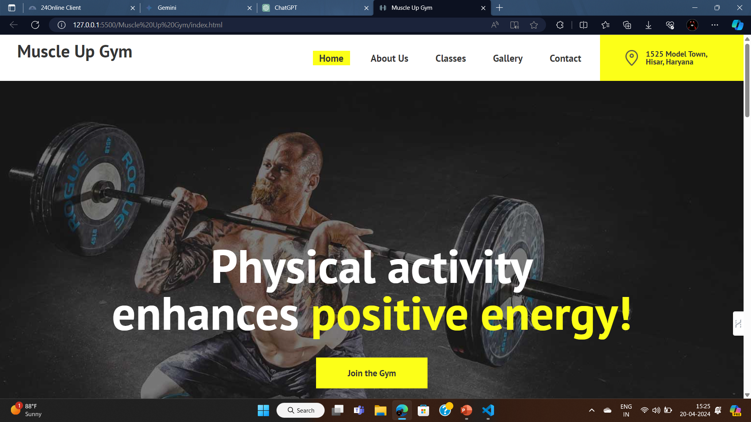

6.Snap Shots

Slide 24
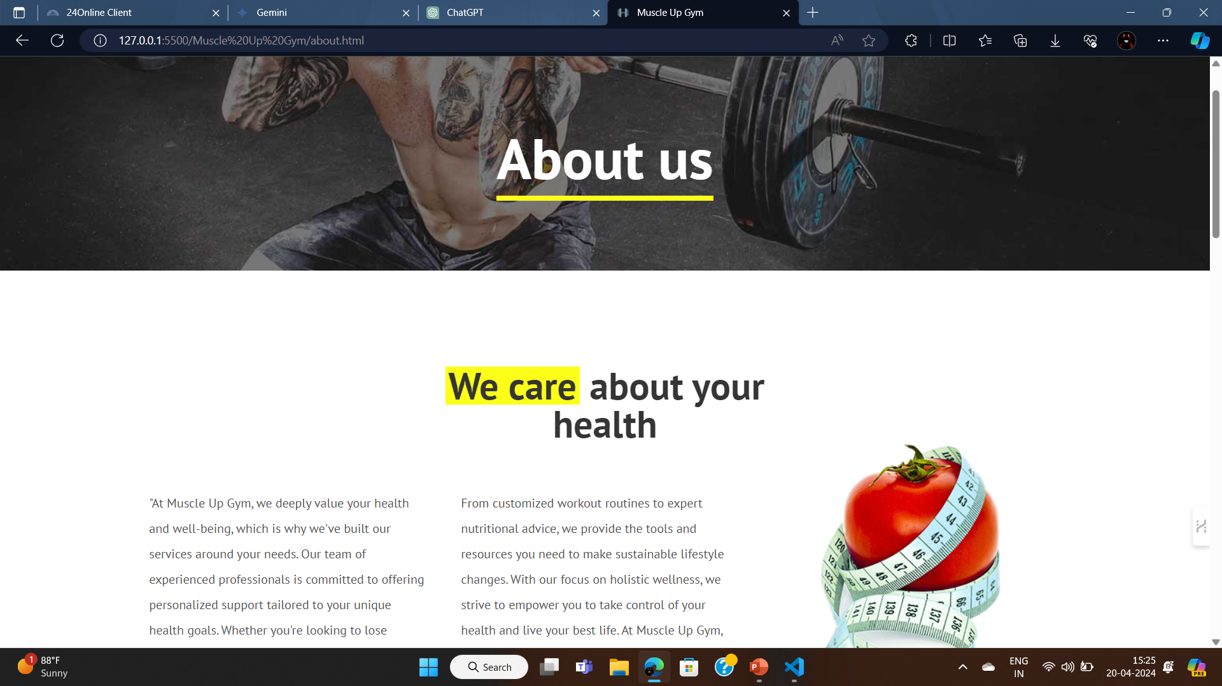
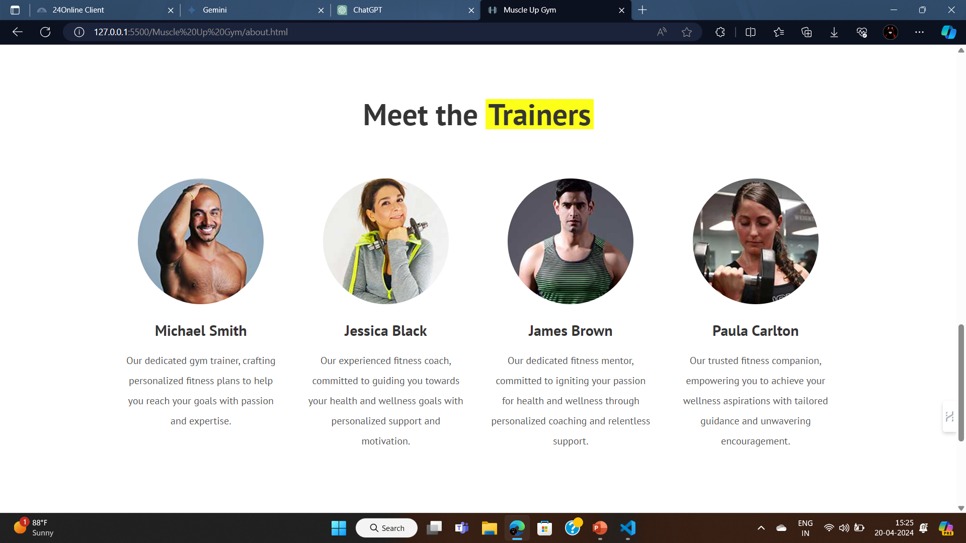

Slide 25
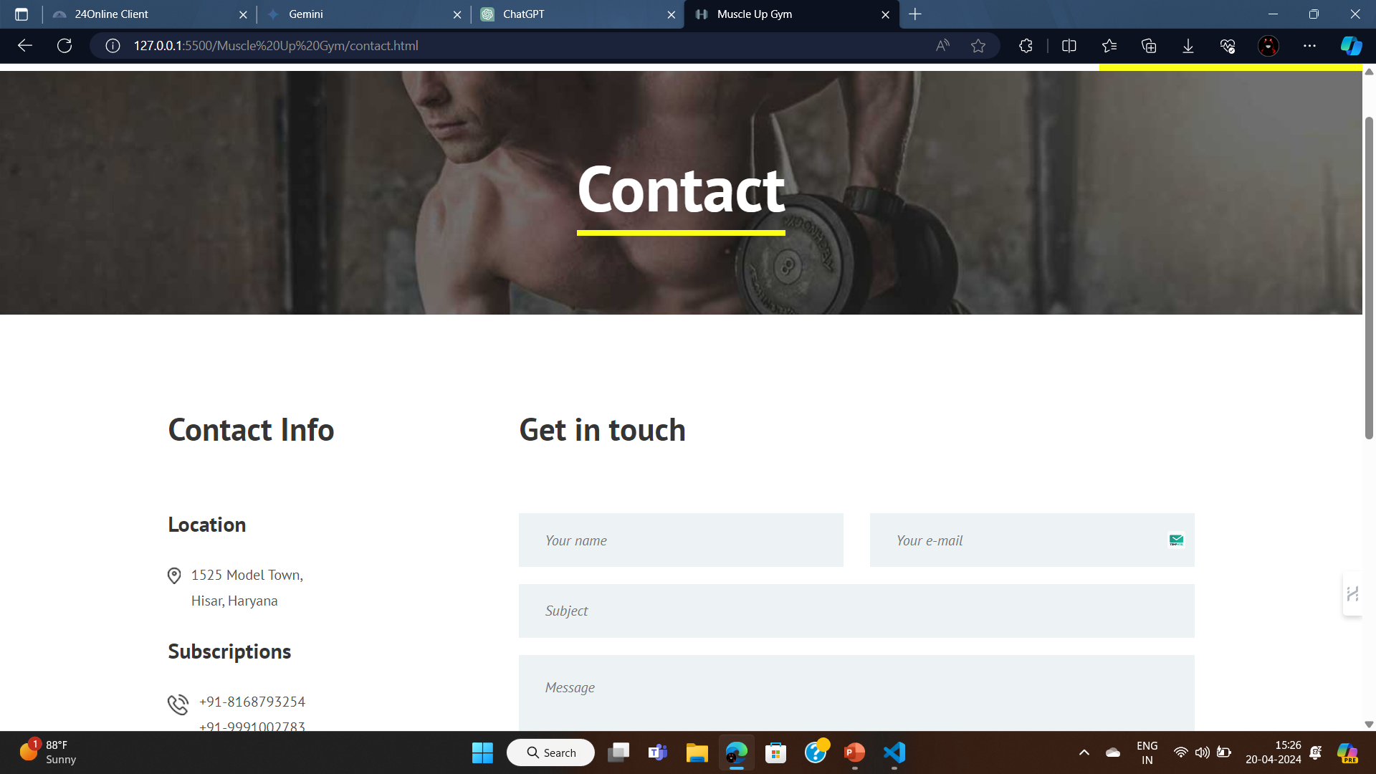
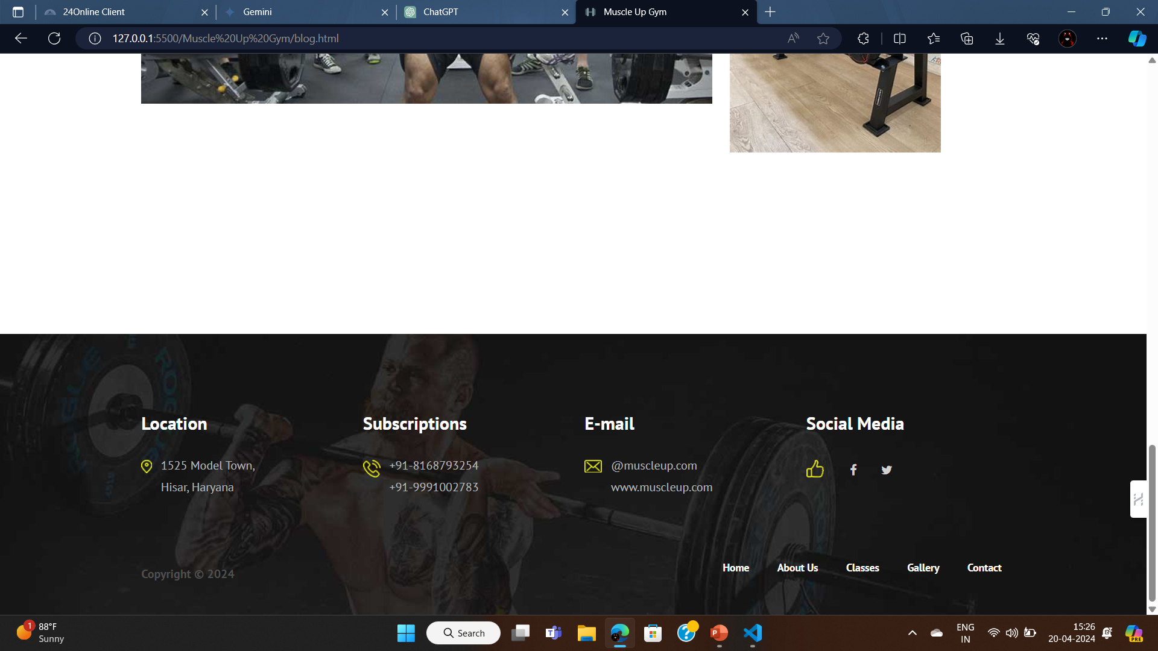

Slide 26
THE END

